Slide 1
Tea-Mates

Slide 2




Meet the Team

Slide 3
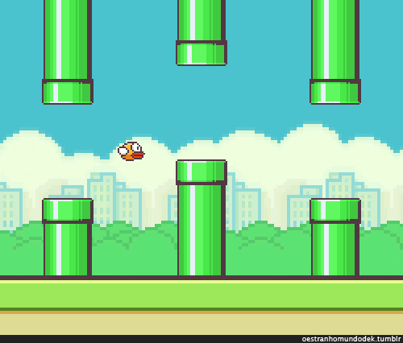
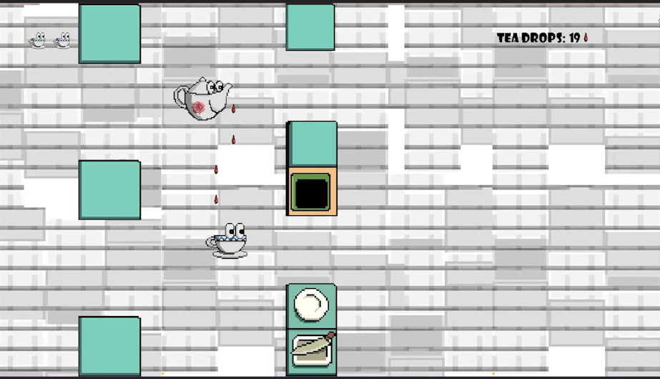
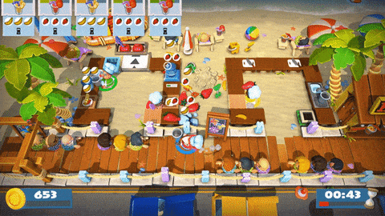



What is Tea-Mates?
Two player co-op
A challenging obstacle course
Delivery and Refilling system

Slide 4





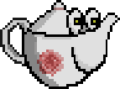
Concept Art
Please enjoy the hard work of our art team

Slide 5




Rules
Health system
Collisions
Limited tea amount
Main objective

Slide 6
Rules
Health system
Collisions
Limited tea amount
Main objective

Slide 7
Upcoming Features
Short-term Plans
Long-term Plans
More Collisions
General UI improvements
New Maps
Tea Types
Multiple delivery zones

Slide 8

Come By And Play Some Time

